Slide 1
Stock Market Investor
201910134 Yang Seongjin

Slide 2
Stock Market Predictor
201910134 Yang Seongjin

Slide 3
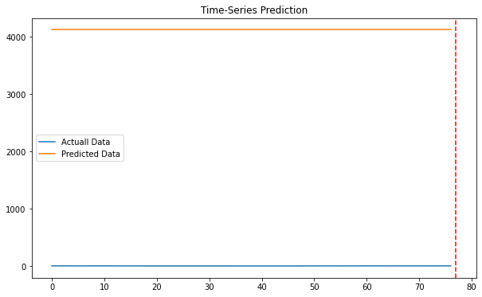
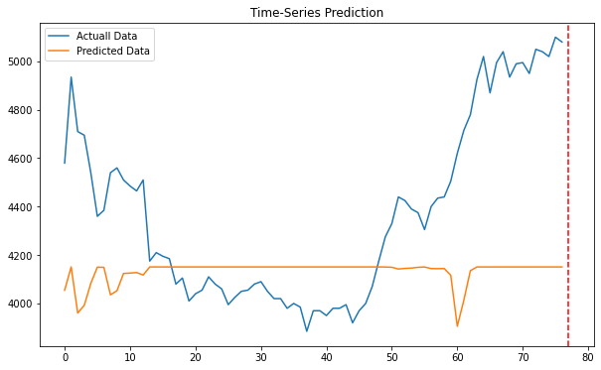
The obstacles I had
KIWOOM API
Not desired results
← I failed on this

Slide 4
I MANAGED THE RESULTS

Slide 5
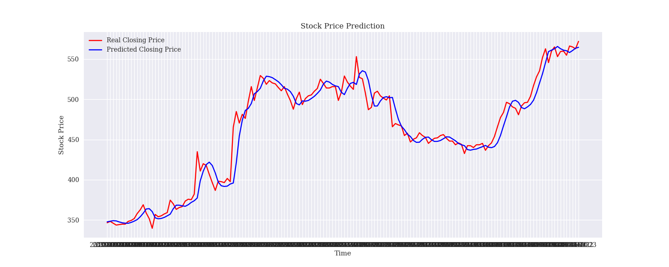
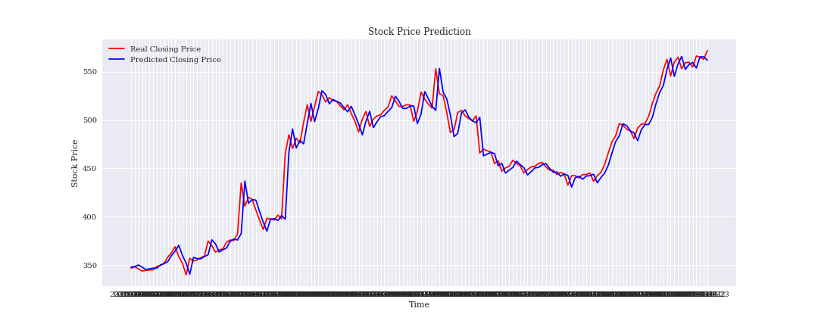
How did I make it?
Get an advice from our professor.
maybe should I not use many features since I am doing it time series which means should be the same data?
Finally, I found that the model I took was using two different normalization methods: standard scaler and minmax scaler. I read every lines and I felt no problems except this.

Slide 6
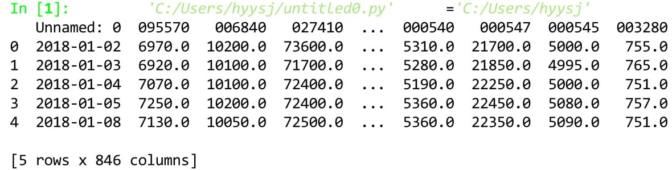
Data I used
The Stock Market Closing value of 845 companies
between 20180101 to 20210423.
Which means 814 working days.

Slide 7
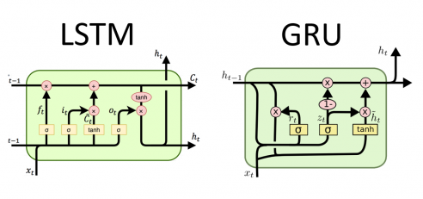
Models I used
LSTM
Trying to forget, or to take older one less important.
GRU
Simplified LSTM
LSTM takes more parameters, but more precise while GRU takes less parameters, but fast.
When you have GPU, what will you use?

Slide 8
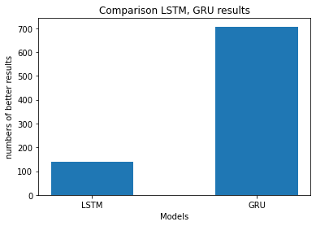
Comparison Performance
RMSE (Root Mean Squared Error)
RMSE is used when you want to know how much the difference between predicted one and the real one.
Lower RMSE = Better result!
GRU showed better results than LSTM

Slide 9

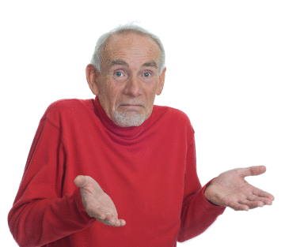
Questions?

Slide 10

Thank you!

